Slide 1
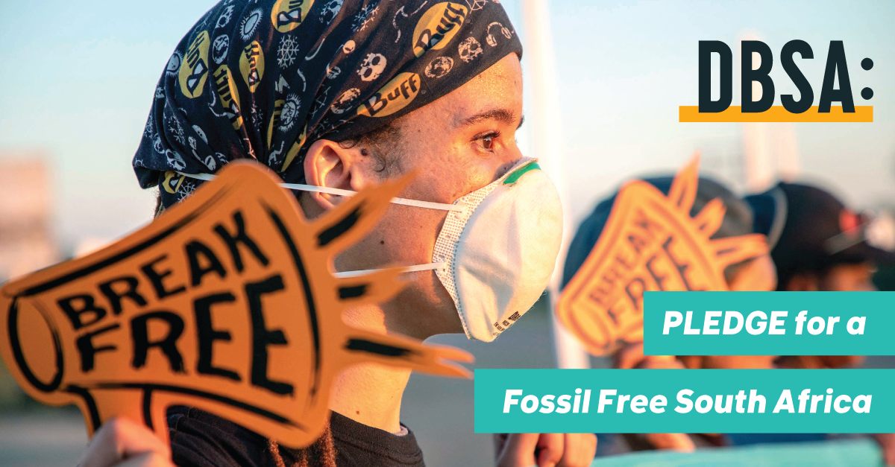
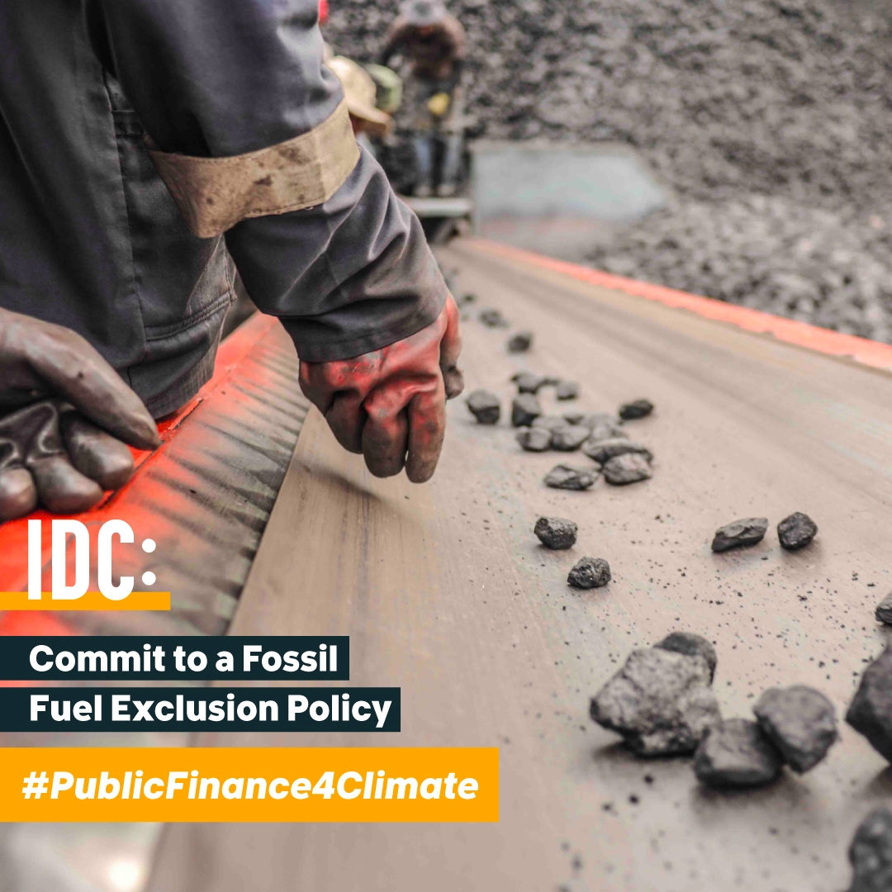
◂350Africa.org Public Finance Campaign
Financing Fairly Webinar
May 2020
◂#FinancingFairly

Slide 2
◂Background: Reasons for Targeting Development Bank of Southern Africa
End of 2017 - Big Shift Global Campaign, informed decision to target DBSA - to stop the money flow into new coal.
Joined Life After Coal coalitions’ campaign against proposed coal IPP’s. 350Africa supported efforts pushing back against DBSA plans to fund Thabametsi.
Our Campaign Strategy: Engage board, employees, and politicians
◂#PublicFinance4Climate

Slide 3
◂Initial Challenges Engaging Public Finance Institutions
Visibility of public finance institutions
Dispute mechanism, however no real strategy to engage for CSO’s
Bank transparency and challenges in accessing key information
◂#FinancingFairly

Slide 4
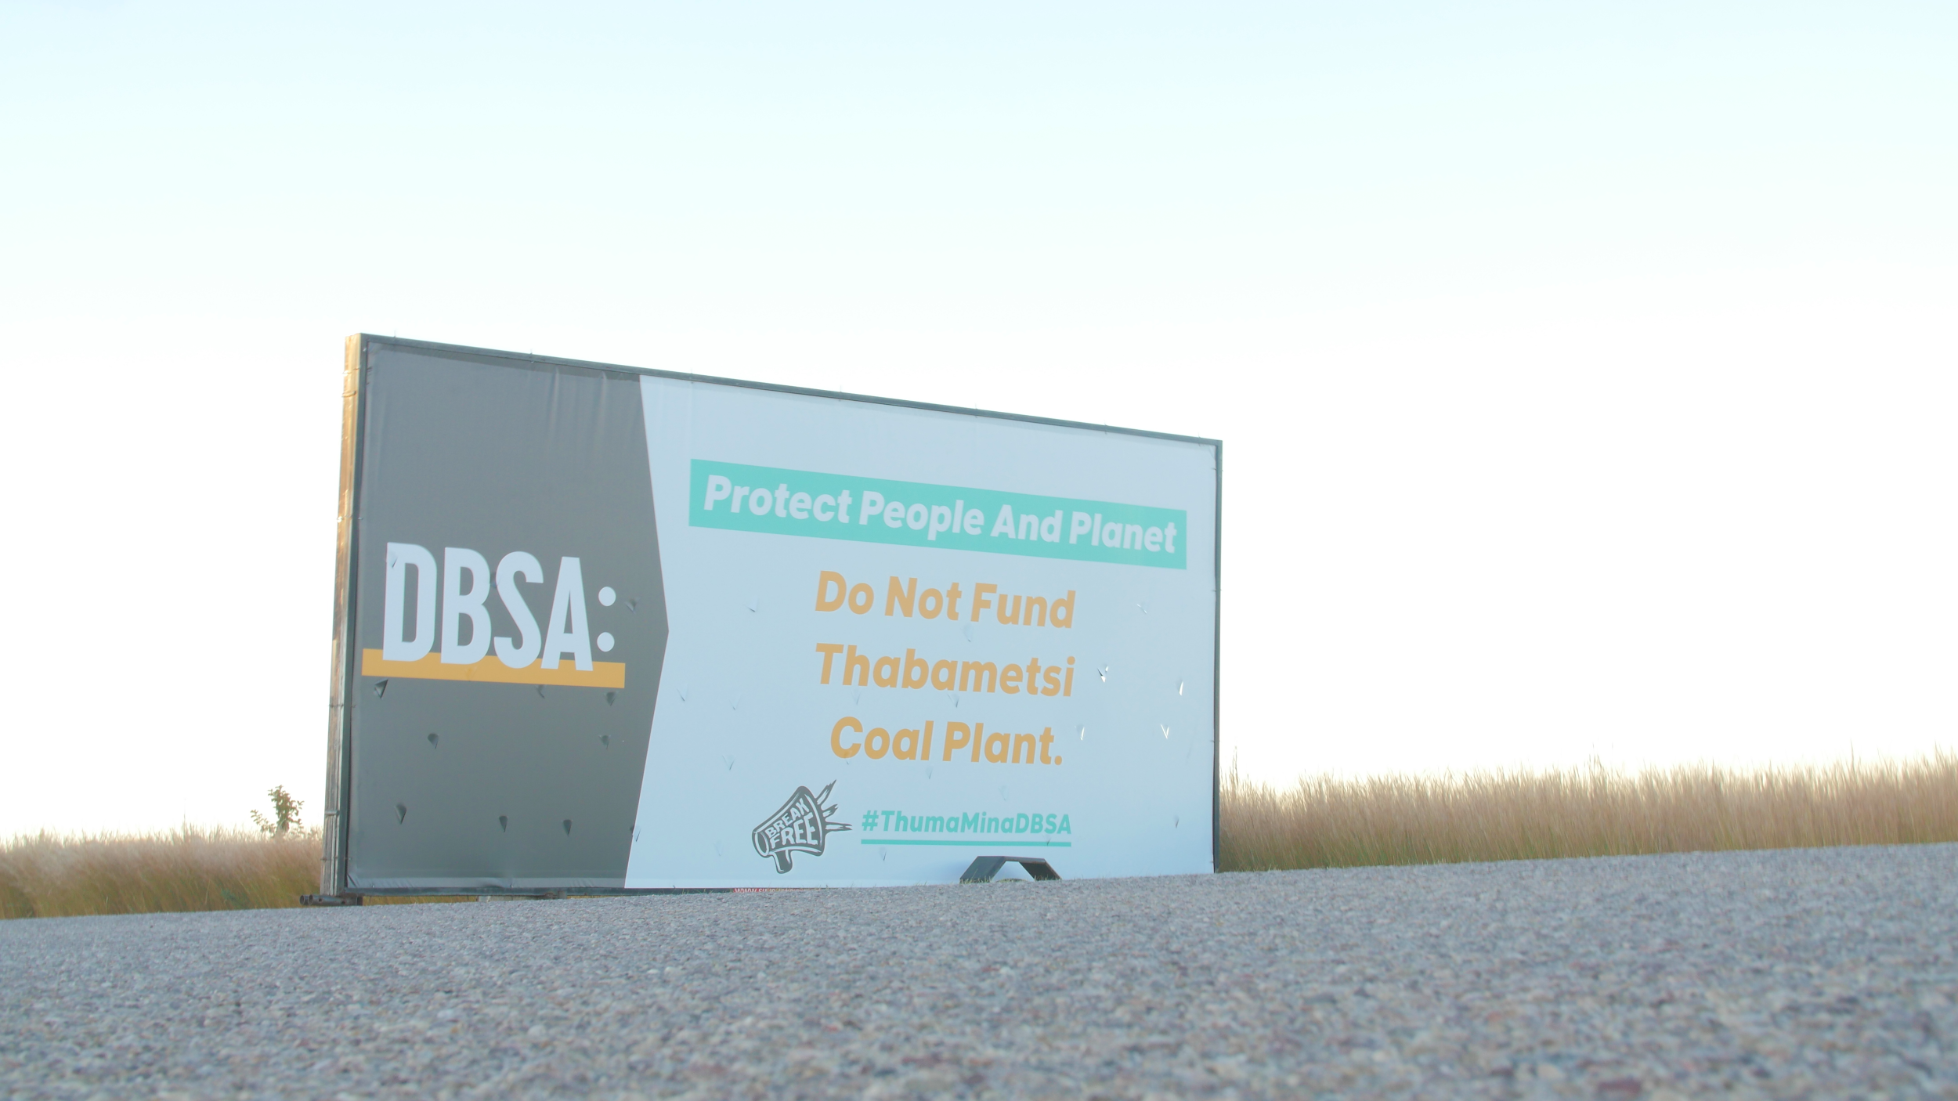
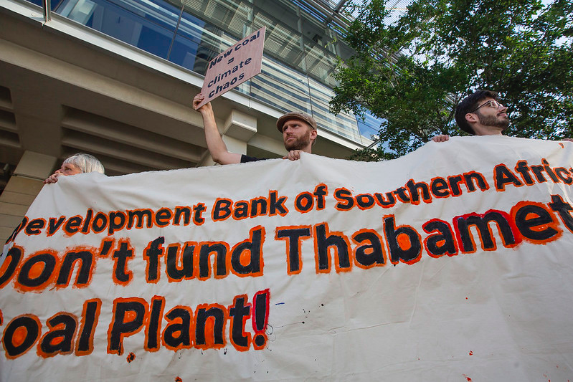
◂Campaign and Engagement Opportunities
Joint letters with partners
Trailer Ads outside DBSA
Petition and movement building
South Africa Energy Week Action
◂#PublicFinance4Climate

Slide 5
◂CER FFGI Assessment: Ongoing Engagement and Advocacy
Opportunity to call on institutions to build public confidence in them fulfilling their stated missions.
Assessment could have informed our thinking in what motivates DBSA and could have been useful in determining a path that would have led to a greater sense of urgency for them to act
At the beginning, the DFI study would have been useful to mobilise support from within, with evidence of gaps and weaknesses in their policies used to play them off against their peers.
Opportunity to call on IDC and DBSA to improve and go further. Eg support a Just Recovery from COVID-19 and transition away from fossil fuels.
◂#JustRecovery

Slide 6
◂ Thank You!
ahmed@350.org
◂#PublicFinance4Climate

