Slide 1
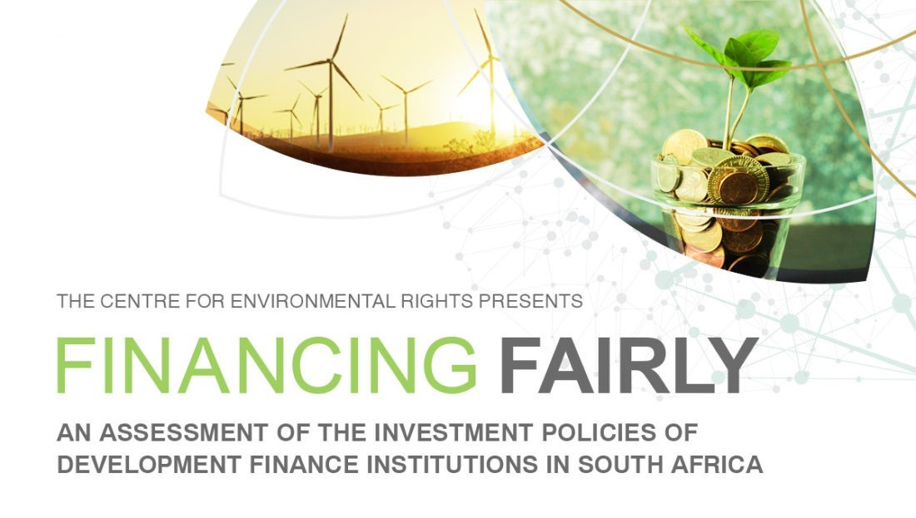

Slide 2











ROLE OF DFI’S: A PUBLIC MANDATE TO FINANCE DEVELOPMENT
“They provide the capital required for the development of infrastructure and production, which enables productive capacity, creates jobs, and builds wealth.”
Development Bank of Southern Africa (DBSA)
Industrial Development Corporation (IDC)
To promote economic development and growth, human resource development and institutional capacity building by mobilising financial and other resources from the national or international private and public sectors for sustainable development projects and programmes.
To promote economic growth and industrial development and develop domestic industrial capacity.
Notes:
1. Development finance institutions – DFIs - are public institutions that offer long-term strategic finance and investments in the private and public sector.
In other words, they provide the capital required for development – they do this, by funding construction of infrastructure and industrialisation, which enable productive capacity, creates jobs, and builds wealth.
There are two DFIs in SA:
Development Bank of Southern Africa – the DBSA
The Industrial Development Corporation – the IDC
3. Established by legislation which sets out their mandate
General - to promote economic development and growth
4. They both operate within strategic sectors
DBSA – focussed on large infrastructure development - water, energy, transport and Information and Communications Technology
5. IDC – focused on industrial development by financing companies - mining, agriculture, manufacturing, tourism and telecommunications.
These DFIs provide public funding to industries with potentially high environmental impacts – whether positive or negative;
They both provide financing and investment in renewable energy.
They have the ability to provide financing necessary for achieving sustainable development and just transition.
--

Slide 3
FINANCE AND INVESTMENT POLICIES MATTER!
Finance and investment policies = criteria & conditions
Guides DFI's decision-making
A tool to facilitate sustainable development
DBSA mission: “To advance the development impact in the region by expanding access to development finance and effectively integrating and implementing sustainable development solutions...”
IDC vision: “To be the primary driving force of commercially sustainable industrial development and innovation for the benefit of South Africa and the rest of Africa.”
Do their policies reflect this?
“DFIs have the potential to fulfil an important role in financing a more equitable and just society, one in which the inter-dependence of people and the environment is valued and protected.”
Notes:
SA DFIs have this mandate to promote economic growth, and although they must conduct their activities within this legislative mandate, they do have crucial decision-making powers when it comes to their finance and investment policies.
They are responsible for setting, in these policies, the criteria with which companies and projects must qualify for their funding, and for the conditions on which that funding must be used.
So these policies serve as a tool that can direct a DFIs capital towards more socially responsible and sustainable projects.
Both the DBSA and IDC have committed to promoting sustainable development in their vision and mission statements, and the question is then whether their policies actually reflect those commitments.
As an environmental justice organization focused on impacts of SA’s mining and energy sector, we were particularly interested in whether these DFIs had policies in place to ensure the protection of the environment in their financing activities, and to facilitate a just transition in SA.
Important for us to use the FFGI methodology for this assessment as it's an international, uses intnl stds and best practices, and has been tried and tested in many countries for commercial banks. This is the first time it's being tested in SA, and the first time its being used to assess the policies of DFIs.

Slide 4
FINDINGS: OVERALL
Assessed 152 elements of international social, environmental, human rights standards under 7 themes, 2 sectors.
Only publicly available finance and investment policies were considered in the assessment.
Political and public policy objectives, may influence DFI decision-making.
The state of development of the country or region from which the DFI originates plays a role.
Differences in development should not excuse a lack of strong policy commitments.
THEMES / SECTORS | EIB (1st) | AFDB (2nd) | FMO (3rd) | DBSA (4th) | NDB (5th) | IDC (6TH) | AVERAGE DFIs
Climate Change | 7.9 | 2.1 | 4.0 | 1.3 | 0.8 | 0.0 | 2.7
Corruption | 8.3 | 7.1 | 7.5 | 3.3 | 3.3 | 3.3 | 5.5
Gender Equality | 6.4 | 3.2 | 2.5 | 3.0 | 1.3 | 1.3 | 3.0
Health | 8.0 | 7.5 | 5.6 | 3.4 | 4.7 | 0.0 | 4.9
Human Rights | 7.7 | 7.7 | 6.2 | 4.0 | 2.3 | 0.0 | 4.6
Nature | 8.7 | 8.0 | 5.3 | 5.6 | 5.0 | 0.0 | 5.4
Financial sector | 1.8 | 2.0 | 1.4 | 0.5 | 0.0 | 0.0 | 1.0
Power Generation | 6.7 | 6.8 | 4.2 | 4.4 | 2.4 | 0.5 | 4.2
Transparency and Accountability | 8.8 | 6.1 | 6.1 | 3.6 | 1.6 | 1.8 | 4.7
AVERAGE SCORE | 7.1 | 5.6 | 4.8 | 3.6 | 2.4 | 0.8 | 4.0
Notes:
What was assessed:
152 elements contained in international social, environmental, human rights standards
Grouped 7 themes 2 sectors
We focus on the DBSA and IDC, ranks 4th and last respectively
For the purposes of this presentation and our report, we also narrow the focus of our analysis to the climate change and power generation sectors, in line with our focus as an organisation.
General comments on interpreting findings – explanations for why the DFI’s did not do so well:
2. Assessment only considered: Publicly available; finance and investment policies
3. DFI policies might be subject to political influence; are required to reflect public policy objectives of the government of the day
4. State of development may influence a country’s commitments to certain standards, as some governments and DFIs argue that they are unable set certain standards
5. But, this should not be used as excuse:
Looking at score of African Development Bank, it performed relatively will on most themes.
It ties with the European Investment Bank on Human rights
As score the highest for power generation
Point: differing levels of development should not affect policy commitments.

Slide 5
FINDINGS: INDUSTRIAL DEVELOPMENT CORPORATION (IDC)
THEMES / SECTORS | IDC (6TH) | AVERAGE DFIs
Climate Change | 0.0 | 2.7
Corruption | 3.3 | 5.5
Gender Equality | 1.3 | 3.0
Health | 0.0 | 4.9
Human Rights | 0.0 | 4.6
Nature | 0.0 | 5.4
Financial sector | 0.0 | 1.0
Power Generation | 0.5 | 4.2
Transparency and Accountability | 1.8 | 4.7
AVERAGE SCORE | 0.8 | 4.0
IDC policies:
The only DFI that does not publicly release any policies
Environmental and Social Policy
Responsible Investment Policy
Corporate Governance Framework for IDC Subsidiaries and Investee Companies
Procurement Policy
Code of Ethics and Business Conduct
Board Charter
“As a public institution, it ought to hold itself to the highest standards of transparency and ensure that critical governance information is available online.”
Notes:
Intro:
IDC performed worst
Zero for most of the themes, below average in all of them
Reason: Did not disclose its policies publicly.
Scores awarded based on statements in Integrated Annual Report
2. Availability of Finance and Investment Policies could have helped the IDC perform better
We know the IDC has policies, because set out in the Integrated Report
But these policies are not publicly available
Even after requesting, they only provided two – which did not help
3. At the least, they must be disclosed because :
Policies enable companies seeking finance to understand the standards and conditions that they must meet
Most importantly
Public institutions must remain accountable to the public.
The policies enable us, the public, to
analyse DFIs’ decision-making,
understand and assess DFIs’ compliance, and
their requirements for investees’ compliance
with environmental, social and governance standards
They must make their policies available online.

Slide 6
FINDINGS: INDUSTRIAL DEVELOPMENT CORPORATION (IDC)
THEMES / SECTORS | IDC (6TH) | AVERAGE DFIs
Climate Change | 0.0 | 2.7
Corruption | 3.3 | 5.5
Gender Equality | 1.3 | 3.0
Health | 0.0 | 4.9
Human Rights | 0.0 | 4.6
Nature | 0.0 | 5.4
Financial sector | 0.0 | 1.0
Power Generation | 0.5 | 4.2
Transparency and Accountability | 1.8 | 4.7
AVERAGE SCORE | 0.8 | 4.0
IDC in practice:
Spending FY2018/19:
Notes:
In the absence of IDC investment policies, we couldn’t conclusively say that their policies do not support sustainability imperatives
So we looked into the investment practices of the IDC
Found that for FY2018/19 – at least 20% of finance went to renewables, but around 14% went to companies reliant on coal which exacerbate South Africa’s greenhouse gas emissions.
It is clear that the IDC’s policies do not fully support a transition to a low-carbon economy.

Slide 7
FINDINGS: DEVELOPMENT BANK OF SOUTHERN AFRICA (DBSA)
THEMES / SECTORS | DBSA (4TH) | AVERAGE DFIs
Climate Change | 1.3 | 2.7
Corruption | 3.3 | 5.5
Gender Equality | 3.0 | 3.0
Health | 3.4 | 4.9
Human Rights | 4.0 | 4.6
Nature | 5.6 | 5.4
Financial sector | 0.5 | 1.0
Power Generation | 4.4 | 4.2
Transparency and Accountability | 3.6 | 4.7
AVERAGE SCORE | 3.6 | 4.0
Transparent – most policies publicly available
Environmental and Social Standards Framework – crucial for DFIs
Grievance mechanism and consultations – affected communities and civil society
High scores: nature, human rights, power generation
Low scores: climate change
Inconsistency between power generation and climate change scoring?
Notes:
DBSA FINDINGS (SLIDE 7)
Ranked 4th out of the six DFIs.
Most of its policies were publicly available, except for a few.
It achieved comparatively good scores, through having a comprehensive Enviro & Social Stds Framework – which is a crucial policy because it sets expectations for clients, and illustrates how a DFI addresses sustainability in support of its development agenda.
DBSA achieved its highest scores under the nature, human rights and power generation theme, and one of its lowest scores under the climate change theme.
The DBSA has established a grievance mechanism for communities that may be adversely impacted by its financed activities, but the results found that the DBSA does not report on that process, nor on its consultations with civil society organisations and other stakeholders.
This aspect of transparency is particularly important for a DFI such as the DBSA whose core mandate is to promote sustainable economic dev and whose financed activities have the potential to have adverse social and environmental impacts.
Now it might seem strange that the DBSA scored well on nature, human rights and even power generation but NOT so well on climate change. Let’s take a closer look at this.

Slide 8
FINDINGS: DEVELOPMENT BANK OF SOUTHERN AFRICA (DBSA)
THEMES / SECTORS | DBSA (4TH) | AVERAGE DFIs
Climate Change | 1.3 | 2.7
Corruption | 3.3 | 5.5
Gender Equality | 3.0 | 3.0
Health | 3.4 | 4.9
Human Rights | 4.0 | 4.6
Nature | 5.6 | 5.4
Financial sector | 0.5 | 1.0
Power Generation | 4.4 | 4.2
Transparency and Accountability | 3.6 | 4.7
AVERAGE SCORE | 3.6 | 4.0
Power generation:
The DBSA does:
Finance companies involved in renewable energy generation;
Have a measurable target to increase its finance for renewable energy generation; and
Require financed companies in the sector to comply with certain social, economic and environmental criteria.
DBSA's green energy projects
Climate change:
The DBSA does not:
Include a measurable target for reducing emissions;
Disclose its financed emissions, nor establish a measurable reduction target for financed emissions;
As an alternative, strive towards a carbon neutral investment portfolio; nor
For its financed companies, indicate any maximum threshold restricting the finance of and investment in fossil fuel extraction and fossil fuel power generation.
DBSA Climate Change Policy Framework not aligned with these standards.
DBSA Environmental Sustainability Strategy not publicly available.
DBSA Energy Sector Investment Framework not publicly available.
But no fossil fuel exclusion policy...
Notes:
DBSA FINDINGS (SLIDE 8)
One of the things the power gen theme assessed is the extent to which the DBSA finances companies involved in RE. The DBSA has made significant strides towards financing RE, through various green projects:
- Contributed to adding clean energy supply into our national grid.
- Played a key role as a funder under our Renewable Energy Independent Power Producer Programme (REIPP).
- It manages the South African Green Fund (established in 2012) on behalf of DEA and
- UN Green Climate Fund accreditation; establishment of a first-of-its-kind climate finance facility using a green bank model (to crowd-in private sector investment).
The cc theme, on the other hand, assessed whether the DBSA’s policies align with intnl cc stds and it deals with cc in a proactive way:
Does it measure and report the carbon footprint of its financing portfolio?
Does it have a strategy to make its portfolio consistent with the internationally agreed 2 deg temp increase limit?
And does it have a strategy to transition to a low-carbon economy, including a switch from fossil fuels to renewables?
Although the DBSA has a Climate Change Policy Framework in place, it does not align with these intnl stds. More importantly, its Energy Sector Investment Framework is not publicly available. Draft but will remain internal.
So while these results show that the DBSA is committed to financing RE, it also reveals the lack of a necessary accompanying shift away from fossil fuel financing. Neither the IDC nor the DBSA have fossil fuel exclusion policies, nor do they demonstrate any strong positions against fossil fuel financing.
There are 2 influencing factors behind this continued financing of fossil fuels by these DFIs, which we’ll take a look at.

Slide 9

POWER GENERATION AND CLIMATE CHANGE: WHY THE INCONSISTENCY?
Political intervention
DFIs are 100% state-owned
Operate in line with a public mandate and in accordance with public policy of the government of the day
Public policy: National Development Plan pushes left, Integrated Resource Plan goes right
One reason: minerals-energy complex
As commercial banks pull out of funding, DFI’s step in
A key challenge = political influence of vested interests in the
fossil fuel industry on policy formulation.
Notes:
POLITICAL INTERVENTION (SLIDE 9)
Being state-owned institutions, DFIs are required to operate in line with public mandates and public policy, and this may influence their policies and decisionmaking.
While SA’s NDP encourages a transition towards a l-c economy, our IRP (which is our national elec plan) makes provision for 1500MW of new coal-based elec in the country’s energy mix.
So the inconsistency btwn DBSA’s investment policies ito power generation and cc, can be seen as a direct reflection of the inconsistencies in our public policies.
In SA, mining continues to be seen as a primary driver of the economy, with coal as a vital export and the main source for energy. This minerals-energy complex is reflected, for example, in the decision to merge our national minerals and energy depts. And as we have seen it play out, this minerals-energy complex continues to be a barrier to sustainable development.
Added to this, is the increasing shift away from fossil fuel financing by commercial banks. As they are pulling out, DFIs have become the funders of last resort for coal and coal infrastrue.
So a key challenge to policy formulation for these DFIs is this political influence.

Slide 10
POWER GENERATION AND CLIMATE CHANGE: WHY THE POOR PERFORMANCE?
Developmental imperatives
Unemployment, inequality, disparities in access to basic resources and services, spatial injustice, widespread poverty
Sustainability < Development
Sustainable Development
There is no binary choice. South Africa has options.
DFIs have a crucial role to play.
Notes:
1. Developmental Imperatives guide DFI decision making
SA frequently top list as the most unequal country in the world. This inequality, structurally ingrained in our society under Apartheid, is largely driven today by unemployment.
Effect: large disparities in wealth, disparities in access basic resources and services, spatial injustice, widespread poverty, so on.
It can hardly be disputed, that fixing unemployment and inequality is South Africa’s highest developmental priority.
If unemployment is a key driver of inequality, then unemployment must be resolved. Urgently.
However, DFIs must address developmental imperatives while ensuring long term sustainability.
The poorest members of our society | are the most vulnerable | to climate change and environmental impacts.
2. If DFI’s fail to consider sustainability issues today – Or if these DFI’s view sustainability as less important than development – DFI’s are setting the most vulnerable people in our population up for more intense effects of inequality and harm caused by climate change further down the road.
3 What we need to do, is flatten the curve, by taking sustainability issues into account now.
5. This means, that there is no binary choice between sustainability and development. DFI’s must align their developmental mandates with sustainability concerns to achieve sustainable development.

Slide 11





WHAT CAN DFIs DO?
A JUST TRANSITION – POWER GENERATION SECTOR
Direct investments towards activities that create decent jobs in the shift to renewables.
Build green industrial capacity
Target specific areas of ESG value chains
Grow demand for renewables & EGS
Stop financing coal!
+ ensure that companies and projects comply with social, environmental, and human rights standards.
Notes:
How do DFIs align their developmental mandates | with climate related goals in the power generation sector?
One way, is to create decent jobs in renewable energy.
Some ideas include:
1. Building industrial capacity, and improving South Africa’s competitiveness, in renewable and environmental goods manufacturing (especially the IDC)
2. Target investments in those parts of the environmental goods and services value chains that create the most jobs, as well as in renewables industries that create the most jobs (e.g. wind tower manufacturing, or solar manufacturing if South Africa can improve its productive capacity in that area sufficiently)
3. Grow demand for renewables. The DBSA, can play a pivotal role here in lobbying government – its partners in the renewable energy independent power producer programme (REIPPP)- to roll our renewable energy procurement rounds, while ensuring the proper functioning of the independent power producer office – without the burden of government interference.
4. Most importantly, stop financing coal
{DFI’s Ensure that companies and projects comply with social, environmental, and human rights standards – this is important to realise a just transition, but also a just recovery from the effects of covid-19.}

Slide 12
WHAT CAN DFI’S DO?
A JUST RECOVERY
IDC COVID-19 relief
Fund for distressed businesses
IDC clients and other businesses in sectors within IDCs mandate
Includes mining, industrial infrastructure, manufacturing, & so on.
Small industrial finance distress fund
IDC clients and other businesses in sectors within IDCs mandate
Short term working capital.
< R50 million turnover
Have a strategy to reduce direct & indirect emissions
Adopt energy efficiency measures
Comply with human rights & labour standards
Strive towards gender equality
Adopt measures to prevent corruption
Amongst others.
Solving today’s crisis should not lead us into another crisis tomorrow.
Solving today’s crisis should not lead us into another crisis tomorrow.
Notes:
The IDC for instance has set up a number of covid-19 relief funds to support businesses.
To ensure a just recovery, the IDC’s finance and investment policies must require the investee companies to:
---- see slide ----
Because solving today’s crisis should not lead us into another crisis tomorrow

Slide 13
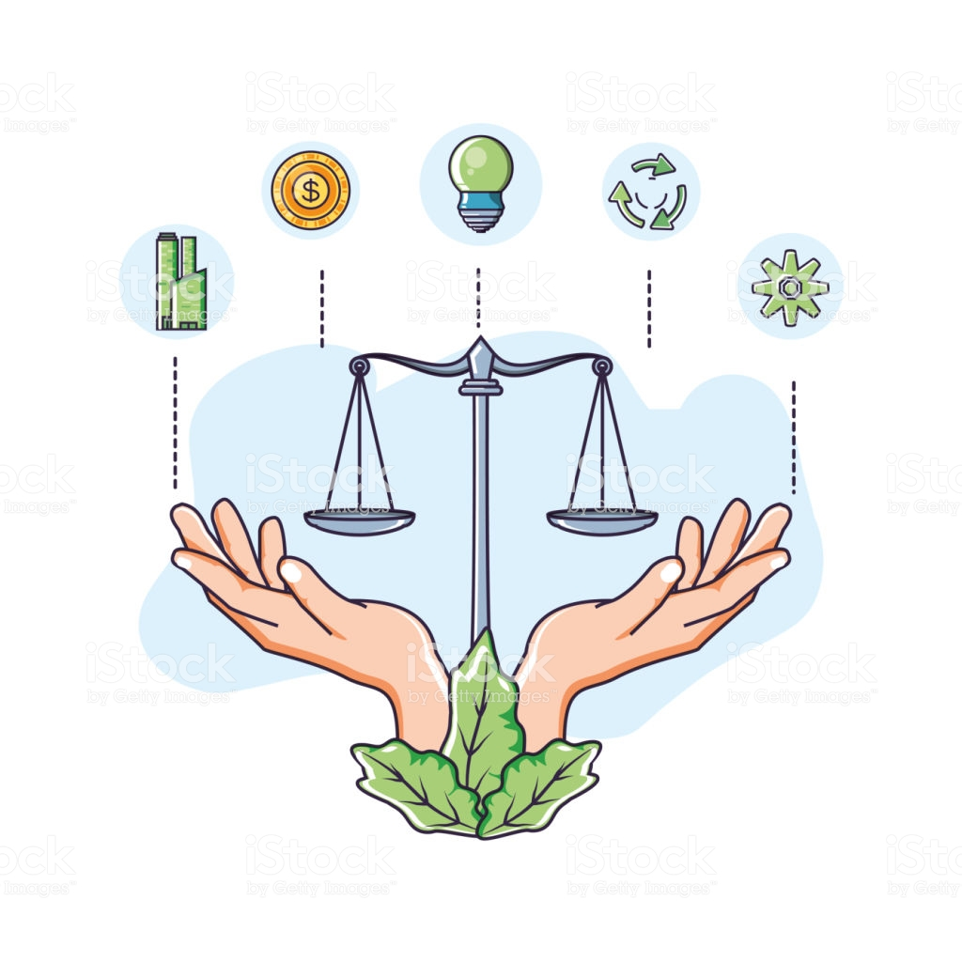
FINANCE & INVESTMENT POLICIES: LOOKING AHEAD – DEVELOPMENT MUST BE SUSTAINABLE
DFIs CAN and MUST resist political influence over their decision making.
DFIs must rethink their role in society – do their policies advance or hinder sustainable development in SA?
Balance economic growth and sustainability:
In line with their mandates, vision & mission, NDP and Constitution, and international standards.
Develop strategies to support a just transition, and a just recovery and ensure that their investment does not lead to harm.
South African DFI must make the necessary commitments in their policies to advance the sustainability agenda, and to ensure a just recovery that adequately responds to the climate emergency.
Notes:
LOOKING AHEAD (SLIDE 13)
Where to from here? SA DFIs can address the political influence over their policies and decision-making, particularly in relation to transitioning to a l-c economy and achieving development in a sustainable manner.
They can do so by relying on their legislative mandates and commitments in their vision and mission, on international stds, on our NDP which dictates a clear outcome of an environmentally sustainable and resilient economy, and by relying on constitutional imperatives for a healthy environment.
As civil society, we should use this basis as a framing for our continued engagement with these DFIs going forward.
While there is a need for economic development in SA, there is an equally important need to address the present and future impacts on climate change.
SA is particularly vulnerable to climate change.
We have strong environmental laws, our implementation and regulation is weak.
DFIs must remember that the right of our people to an environment that is not harmful to our health or well-being should not be seen as a mere trade-off, and needs to be balanced with developmental goals.
We are saying that this balance can be achieved in the form of sustainable development.
And developing clear and ambitious policies aligned with environmental, social and human rights standards is a necessary step in that direction.
This current covid crisis, coupled with the ongoing climate crisis, offers DFIs an opportunity to advance the sustainability agenda and a just recovery.

