Slide 1
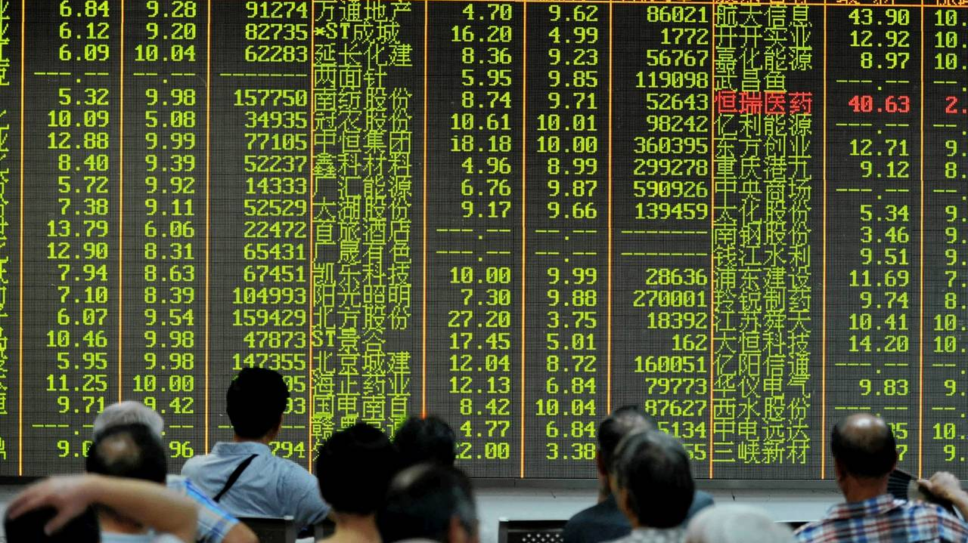

Fair Finance Guide International May 2020

Slide 2

Fair Finance Guide 2014: Funded 2020: 11 guides, 14 countries
Financial sector crucial role in
avoiding human rights breaches and destruction environment
contributing to poverty reduction and sustainable inclusive development
Financial sector has major influence on companies and corporations all over the world
Major opportunity to involve citizens with ‘money in the bank’ in what that money does elsewhere in the world

Slide 3

FFI pathway of change
Change in financial institutions’
and their regulatory environment
Impact on the ground
Defining the problem
Research influencing & advocacy
Change in companies
invested in

Slide 4
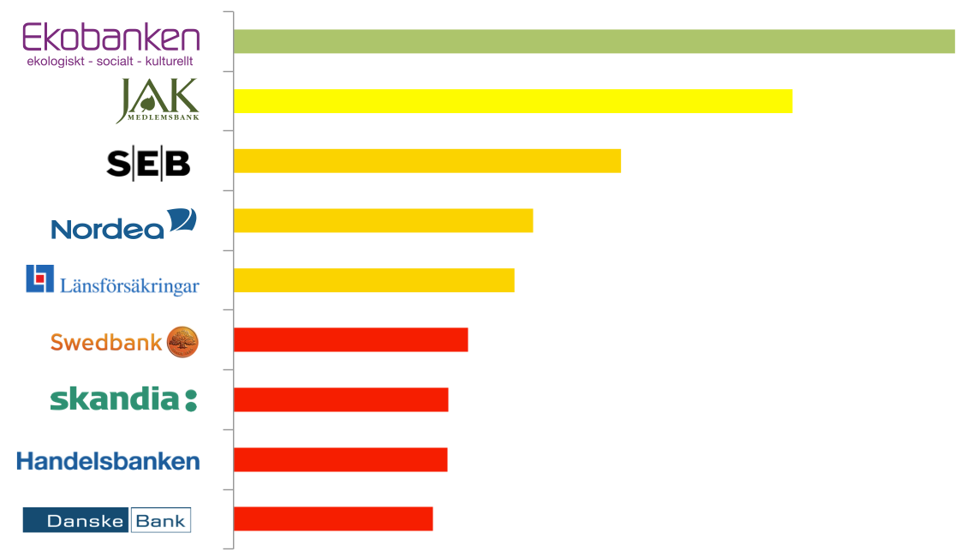





FFGuide in brief
An international method for benchmarking sustainability policies of financial instituions
Reference to compair with actual investment practice of the FI’s
Provides online information for consumers and investors to make informed choices and voice concerns
Used by national CSO coalitions in all parts of the world

Slide 5











11 countries have launched national guides

Slide 6







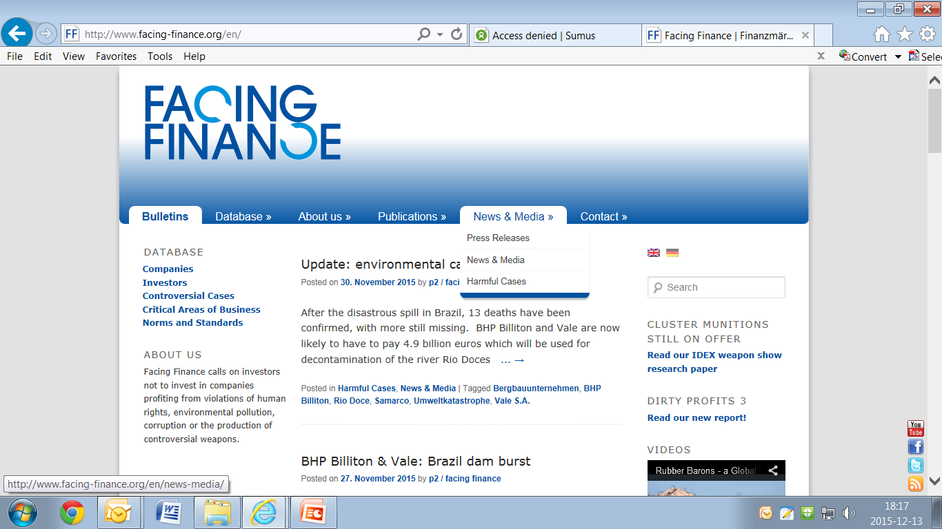



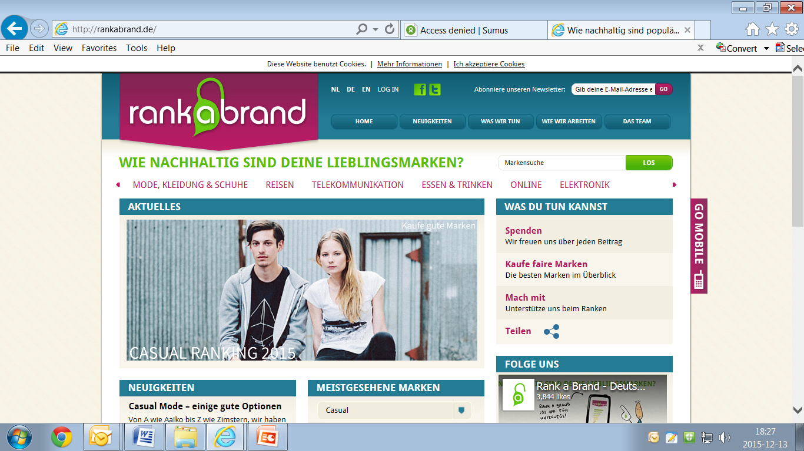


























46 organizations involved globally – network with national focus

Slide 7
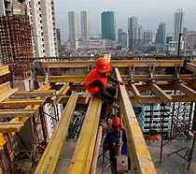
FFI in short
Local coalitions in 11 countries
Started with Bank Guides, now also Insurance Guides and Pension Guides
Policies of over 115 FIs assessed on at least 9 common themes using a common methodology
All in in local languages
Campaigned with 69 case studies
Over one million unique website visitors
Improvement of FI’s policies and practices
Increasing leverage with regulators
Engagement FI with corporations & divestments
http://fairfinanceguide.org/

Slide 8
National coalitions in an international network
At national level:
Dedicated civil society organizations -> a coalition
With a variety of expertise
On topics: human rights, inequality, climate, consumers, environment, etc.
On skills: research, advocacy, lobby and campaigning skills
At international level:
Well developed, robust and tested research methodology
Support and quality control of research
Coordination for coherence and collaboration amongst countries
Linking to other CS initiatives influencing the financial sector worldwide

Slide 9
Campaign toolbox
Beyond policy into practice and change
Policy assessments: work as the carrot: race to the top
Case studies & Quick Intervention Cases
=> reveal the inconsistencies, where practice conflicts with words
Engaging with regulators: up the level playing field

Slide 10
Campaign successes FFI:
Divestment from coal & tar sands
Divestment from private detention company GEO, also active in South Africa
Abusive credit policies by Brasilian banks
Engagement FIs with companies on living wage (food, garment)
Engagement FIs with companies on affordable medicines
Divestment from tax evading companies
More transparency among Financial Institutions
Financing deforestation: palm oil, soy
Arms exports: ban on investing in cluster munition (NL)

Slide 11
FFG coalition in South Africa?
Relevance, added value, potential
Need for pressure on corporations and investments to limit harmful impacts on human rights, environment.
South Africa commercial and development banks relevant targets for their investment portfolio
Potential of a regional impact
First FFG on African continent welcomed by FFI network

