Slide 1



Applying the Fair Finance Guide Methodology to DFIs
27 May 2020

Slide 2
Brief introduction of Profundo
Independent not-for-profit company with 30 years of sustainability research experience
20 experienced research professionals from 10 countries
Our
Experience
Established in 2000 in Amsterdam
Long-standing, global client base
NGOs, governments, foundations and investors
Our
Clients
Our
Competencies
Strong knowledge of the financial sector, policy developments and the impacts of businesses and financiers on sustainability aspects
Understanding different sustainability issues and standards
Customized research and advice to help our clients with fostering sustainability and social justice
Notes:
Our strongest features can be summarised in terms of expertise, people and competency. I would like to point out that we have grown in ten years from a one-men business to a small enterprise with 20 people who all have different backgrounds and nationality, amongst which are people from India and Indonesia. They also share a passion to built a sustainable and just world, determining our choice for projects that contribute to that one way or the other.

Slide 3
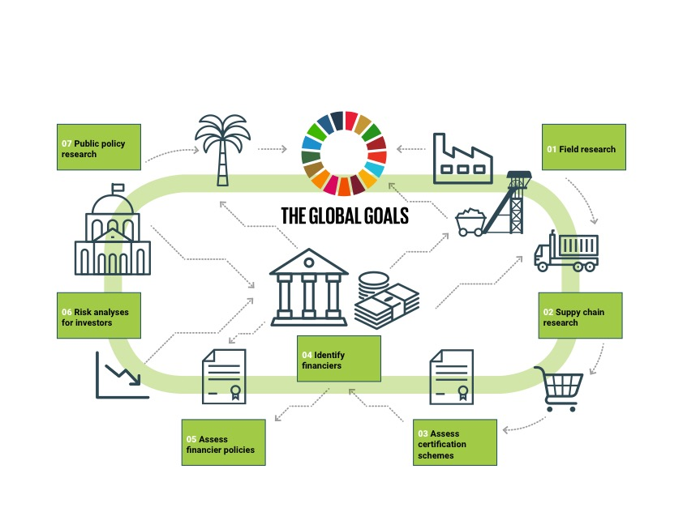
Approaches to influence corporates

Slide 4
What is the Fair Finance Guide?
Fair Finance Guide (FFG) methodology developed by Profundo and FFI network to assess banks’ investment and lending policies
  Overview of international standards & initiatives
  Standards are used as background and foundation for FFG assessment elements
  Indicates what a financier should expect of a company
  Take into account public information only
Policy assessment should be complemented by case studies to see what banks do in practice

Slide 5
Scope and objectives of the study
Scope
  Six Development Finance Institutions (DFIs) including bilateral and multilateral: AfDB, DBSA, EIB, FMO, IDC, NDB
  9 themes evaluated
  For each theme both quality and scope of policies have been evaluated
Objectives
  Assess DFIs policies’ alignment with international CSR standards
  Identify areas of improvement for DFIs
  Advocacy tool for engagement with governments and regulators
Specificities taken into account
  Majority-owned by governments
  Act under a specific political mandate in certain regions or countries

Slide 6
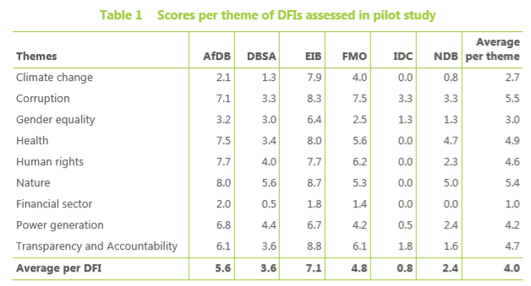
Main findings

Slide 7
Thank you for participating!
More information:
Juliette Laplane
j.laplane@profundo.nl

